Slide 1

Predicting CO2 Emissions of Vehicles Using Real-Time Telematics Data
Data 602 Project Presentation-GROUP 2
Professor : Masoud Soroush
Presented By:
Akhilesh Akoju
Kianoush Ramezani Shabolaghi
Lokesh Reddy Kuppireddy
Sai Akhil Sadula
Suraj Hanumanthapura Chandra

Slide 2
Introduction
The primary aim is to analyze and predict CO2 emissions from various vehicles using the 'Car Fuel & Emissions 2000-2013' dataset.
Leveraging vehicle data to predict CO2 emissions, aiming to contribute to the development of greener transportation options.
Explore patterns and relationships to understand the factors influencing vehicle emissions, contributing to better environmental management.
Apply machine learning techniques to forecast emissions, aiming to enhance environmental planning.

Slide 3
Objectives
Develop machine learning model that accurately predicts CO2 emissions based on vehicle data.
Identify key factors that significantly influence vehicle emissions.
To Determine how engine capacity correlate with CO2 emission.
Analyzing if certain manufacturers and models have better emission standards.
Predicting noise level based on engine capacity, fuel type and transmission type.
To find , whether we can predict fuel efficiency based on engine capacity, transmission type and fuel type.
Evaluating CO2 emissions based on vehicles’s model year.

Slide 4
Dataset Overview
Data source:
https://data.world/amercader/car-fuel-emissions-2000-2013
The dataset encompasses diverse vehicle specifications, including emissions (CO2, NOx, CO) and noise levels, linked to engine size, fuel type, and compliance standards.
Serves as a foundation for developing machine learning models to predict emissions and fuel efficiency, vital for sustainable environmental strategies.
Assists in understanding how different vehicle specifications align with emission standards, offering data-driven support for policymaking.

Slide 5
Columns Description
file: Indicates the data file from which the record is sourced.
year: The year in which the vehicle model was manufactured or released .
manufacturer: The brand or company that produced the vehicle.
model: The specific name or designation given to a vehicle by the manufacturer.
description: Provides additional details about the vehicle, which may include specific features, engine size, or special edition names.
euro_standard: European emission standards compliance level of the vehicle.
tax_band: A classification used to determine the vehicle tax rate, often based on CO2 emissions levels.
transmission: Specifies the type of gearbox in the vehicle, such as manual or automatic, along with the number of gears.

Slide 6
transmission_type: Categorizes the transmission into broader types, such as manual, automatic, or semi-automatic.
engine_capacity: The volume of the engine's cylinders, usually measured in cubic centimeters (cc) or liters, which is indicative of engine size.
fuel_type: The type of fuel the vehicle uses, such as petrol, diesel, electric, or hybrid.
urban_metric: Fuel efficiency in urban environments with frequent stops and starts, measured in liters per 100 kilometers.
extra_urban_metric: Fuel efficiency under steady-speed conditions, such as highways, measured in liters per 100 kilometers.
combined_metric: An average of urban and extra-urban fuel efficiency, providing a general measure of fuel consumption in liters per 100 kilometers.
urban_imperial: Fuel efficiency in urban environments, measured in miles per gallon, using the imperial system.
extra_urban_imperial: Highway fuel efficiency, measured in miles per gallon in the imperial system.

Slide 7
combined_imperial: The average fuel efficiency combining urban and extra-urban conditions, measured in imperial miles per gallon.
noise_level: The amount of noise the vehicle produces during operation, measured in decibels (dB), which is important for environmental noise pollution assessments.
co2: The amount of carbon dioxide emissions the vehicle produces, a key factor in global warming, usually measured in grams per kilometer (g/km).
thc_emissions: Total hydrocarbon emissions from the vehicle, which contribute to smog and are measured in grams per kilometer (g/km).
co_emissions: Carbon monoxide emissions from the vehicle, an odorless gas that can be harmful or fatal in high concentrations, measured in grams per kilometer (g/km).
nox_emissions: Nitrogen oxides emissions from the vehicle, which contribute to air pollution and acid rain, measured in grams per kilometer (g/km).

Slide 8
thc_nox_emissions: Combined emissions of total hydrocarbons and nitrogen oxides, which are collectively regulated due to their environmental impact.
particulates_emissions: This column measures the particulate matter (PM) emissions from the vehicle, which are tiny particles that can penetrate the lungs and cause health issues. Particulate emissions are of particular concern for diesel engines and are typically measured in grams per kilometer (g/km).
fuel_cost_12000_miles: : Estimated cost of fuel for traveling 12,000 miles, an indicator of the vehicle's long-term fuel economy.
fuel_cost_6000_miles: Estimated cost of fuel for traveling 6,000 miles, useful for short-term budgeting of fuel expenses.
standard_12_months: Likely refers to the standard cost of vehicle taxation or registration for a 12-month period.
standard_6_months: Similar to the above but for a 6-month period, possibly providing a shorter-term cost option for vehicle taxation or registration.

Slide 9
first_year_12_months: Costs associated with the first year of vehicle ownership, which may include higher rates of taxation or additional fees.
first_year_6_months: The cost for the first 6 months of owning the vehicle, which might also include initial taxes or fees that are specific to new vehicles.
date_of_change: Records the date when any changes were made to the vehicle's specifications or to the data entry, which can be important for tracking revisions or updates in the dataset.

Slide 10
Data Preprocessing
Initially, the dataset contains 45,511 rows, 31 columns in total.
Removed below 10 columns-high missing data , less impact on our research questions.
thc_nox_emissions, particulates_emissions, thc_emissions, fuel_cost_6000_miles, fuel_cost_120000_miles, standard_12_months, standard_6_months, first_year_12_months, first_year_6_months, date_of_change.
Columns with Inconsistent data: mixed data types and unclear data,tax_band, date_of_change

Slide 11
Data Preprocessing
Redundant columns:
Since, Imperial system is prevalent, and fuel efficiency is customarily expressed in miles per gallon (mpg).
Considered- urban_imperial, extra_urban_imperial and combined_imperial
Removed- urban_metric, extra_urban_metric and combined_metric
Columns not relevant to our analysis: financial aspect,standard_12_months, standard_6_months, first_year_12_months, and first_year_6_months

Slide 12
Final Columns : 15
8 Continuous: engine_capacity, urban_imperial, extra_urban_imperial, combined_imperial, noise_level, co2, co_emissions, nox_emissions.
7 Categorical: Year, manufacturer, model, euro_standard, transmission, transmission_type, fuel_type
Handling missing values:
Continuous : Median
Categorical : Mode

Slide 13
Target Variable and Features selection
The Target variable is ‘co2’.
Amongst the 31 variables, most relevant variables on available data and characteristics are: Year, manufacturer, model, euro_standard, transmission, transmission_type, engine_capacity, fuel_type, urban_imperial, extra_urban_imperial, combined_imperial, noise_level, co_emissions, nox_emissions,

Slide 14
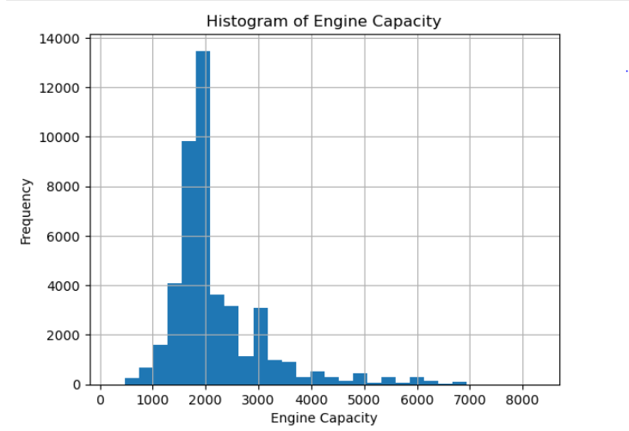
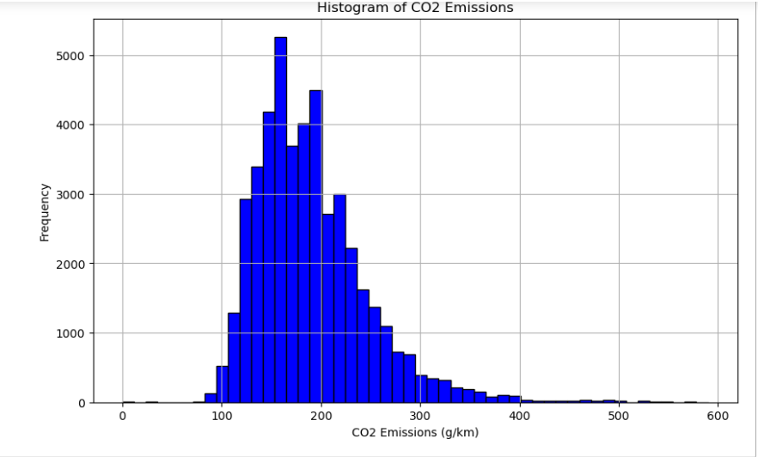
Exploratory Data Analysis
Most vehicles have smaller engines, and fewer vehicles have larger engines
As CO2 emissions increase, the number of vehicles decreases

Slide 15
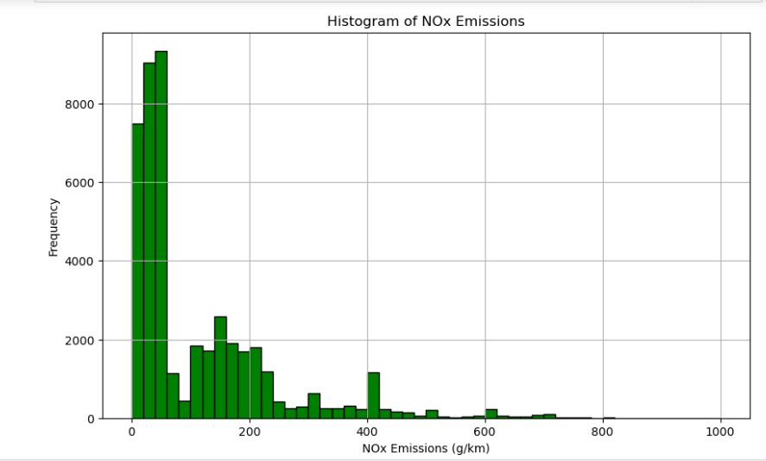
A high frequency of vehicles have low NOx emissions.
As the NOx emissions increase, the frequency of vehicles drastically decreases.
Indicates that higher NOx emissions are much less common in this dataset

Slide 16
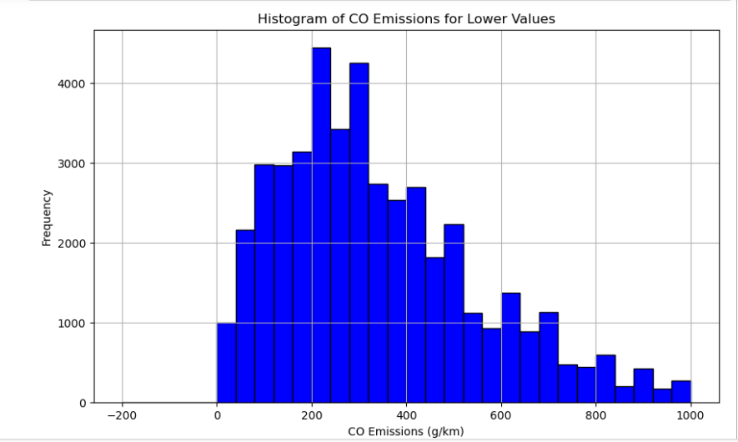
Right skewed-Many vehicles have relatively low CO emissions.

Slide 17
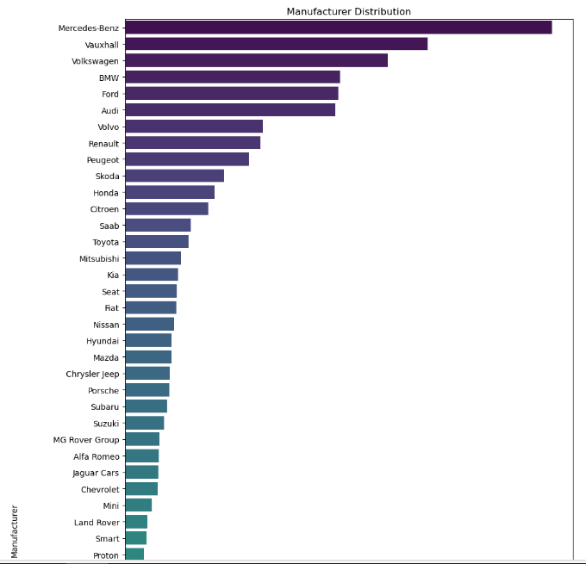
Count of vehicles by different manufacturers.

Slide 18
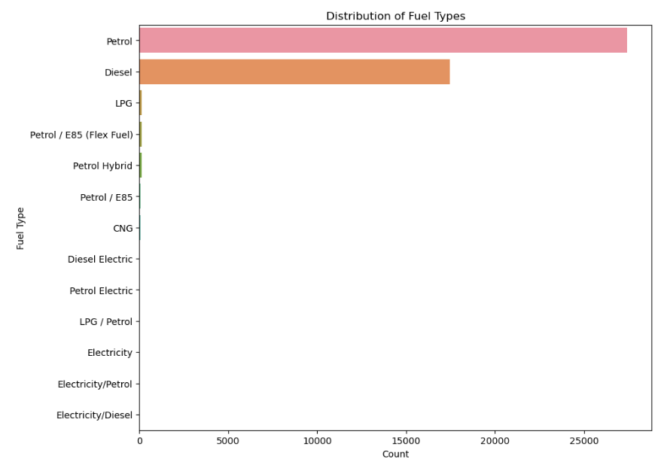
Petrol and Diesel are predominant.

Slide 19
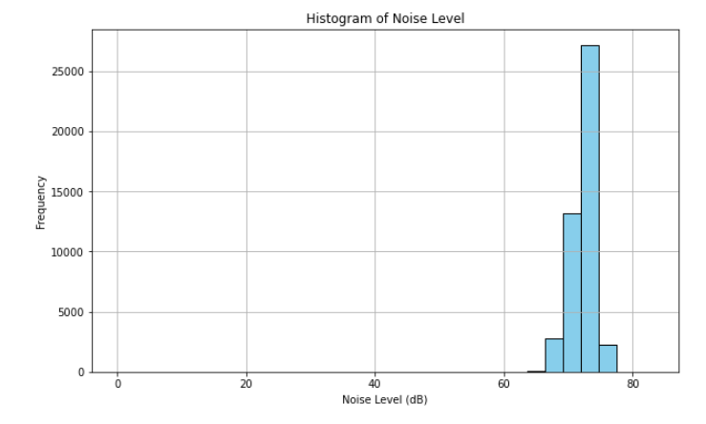
Unimodal-fewer vehicles have lower or higher noise levels compared to the central peak.

Slide 20
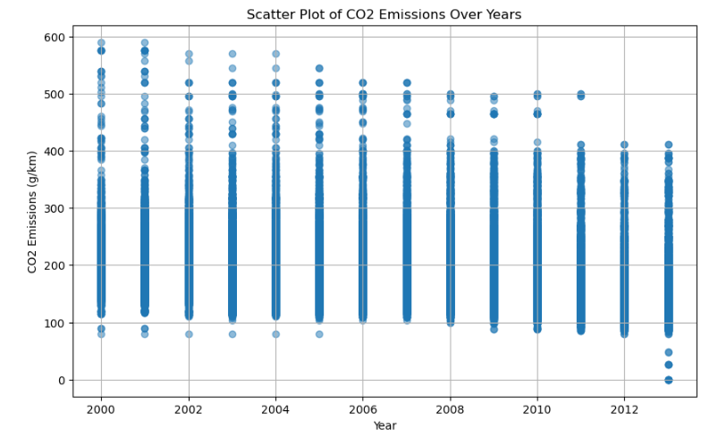
Does not show a clear trend in CO2 emissions reduction or increase over time.

Slide 21
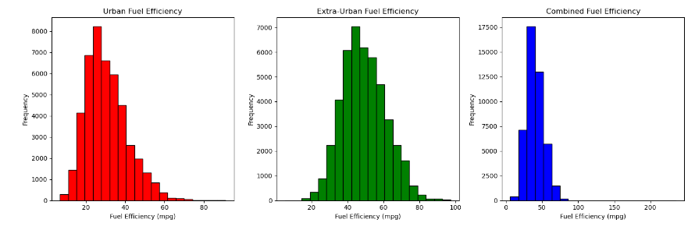
Better overall efficiency but still less than extra-urban driving
Less efficiency
More fuel-efficient

Slide 22
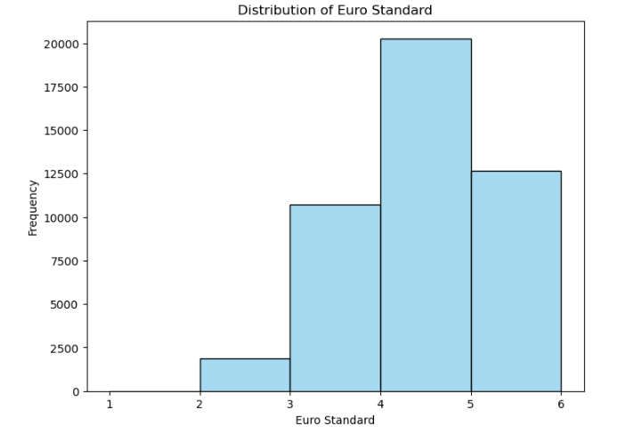
Euro 4 standards were actively enforced.
Euro 1 and Euro 2 -phasing out of older vehicles.
Euro 5 and Euro 6-potentially reflecting the transition.

Slide 23
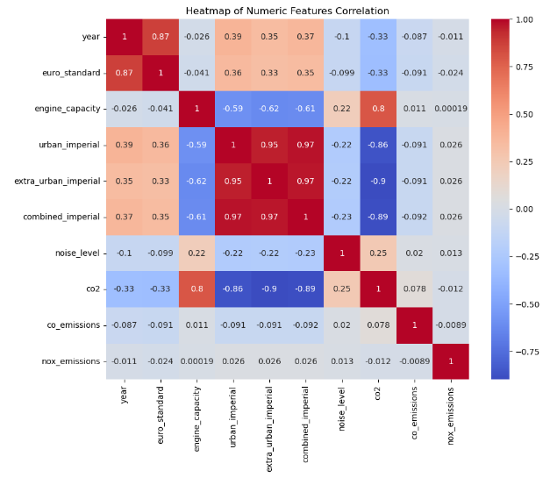
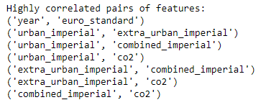

Slide 24
Insights
Year (-0.3274): This negative correlation indicates that newer vehicles (higher 'year') tend to have lower CO2 emissions. This could be due to advancements in technology, more efficient engines, and stricter emission standards in newer models.
Euro Standard (-0.3289): Similar to 'year', the negative correlation here suggests that vehicles conforming to higher Euro standards (which are stricter in terms of emissions) are associated with lower CO2 emissions. This aligns with the objective of these standards to reduce vehicle emissions.
Engine Capacity (0.7974): A strong positive correlation indicates that larger engine capacities are associated with higher CO2 emissions. This is expected, as larger engines typically consume more fuel.

Slide 25
Insights
Noise Level (0.2518): This positive but weaker correlation suggests a mild association between higher noise levels and higher CO2 emissions. This might reflect larger or more powerful engines that both emit more noise and CO2.
Urban Imperial (-0.8614), Extra Urban Imperial (-0.8985), Combined Imperial (-0.8854): These strong negative correlations indicate that higher fuel efficiency (measured in miles per gallon in urban, extra-urban, and combined settings) corresponds to lower CO2 emissions. This is logical as more fuel-efficient vehicles use less fuel for the same distance and thus emit less CO2.
The values indicate that engine capacity and fuel efficiency metrics are particularly strong predictors of CO2 emissions. The 'year' and 'euro_standard' also play significant roles, reflecting changes in vehicle technology and regulations over time.

Slide 26
Machine Learning Models
Linear Regression
Visualizing the Effects of Lasso(L1) and Ridge(L2) Regularization on CO2 Emission Prediction
Decision Trees
Bagged Decision Tree Regressor
Random Forest
Gradient Boosting
Neural Network
Support Vector Regressor
KNN Regression
AdaBoost Regression
Bayesian Regression

Slide 27
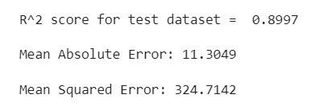
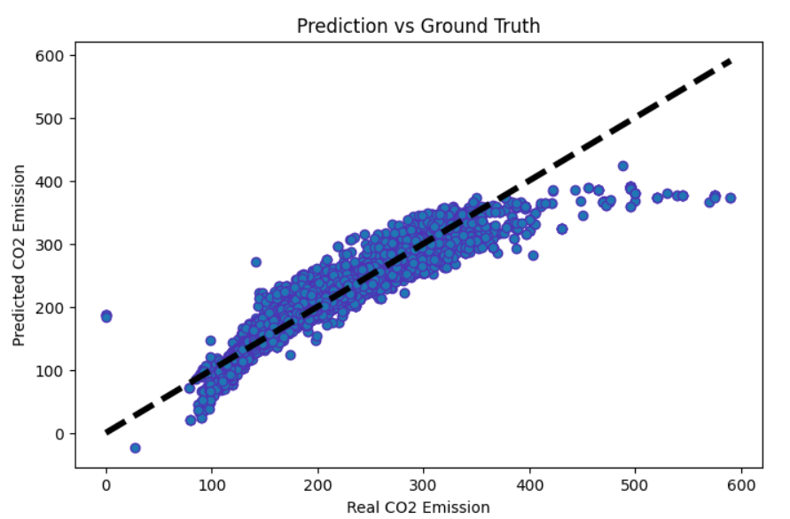
Linear Regression

Slide 28
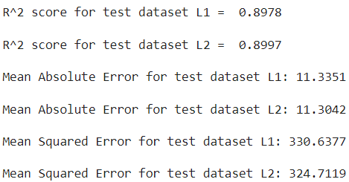
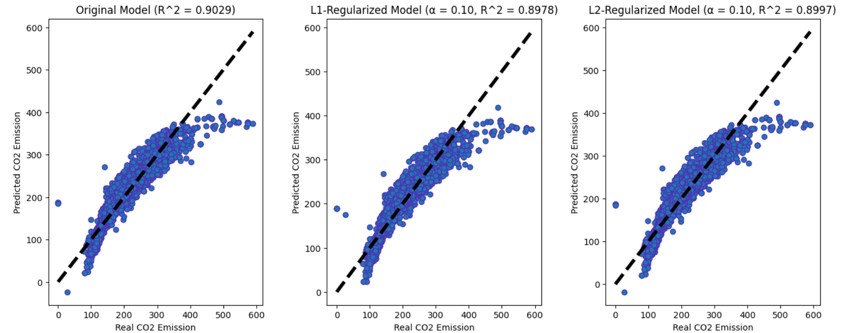
Visualizing the Effects of Lasso(L1) and Ridge(L2) Regularization on CO2 Emission Prediction

Slide 29
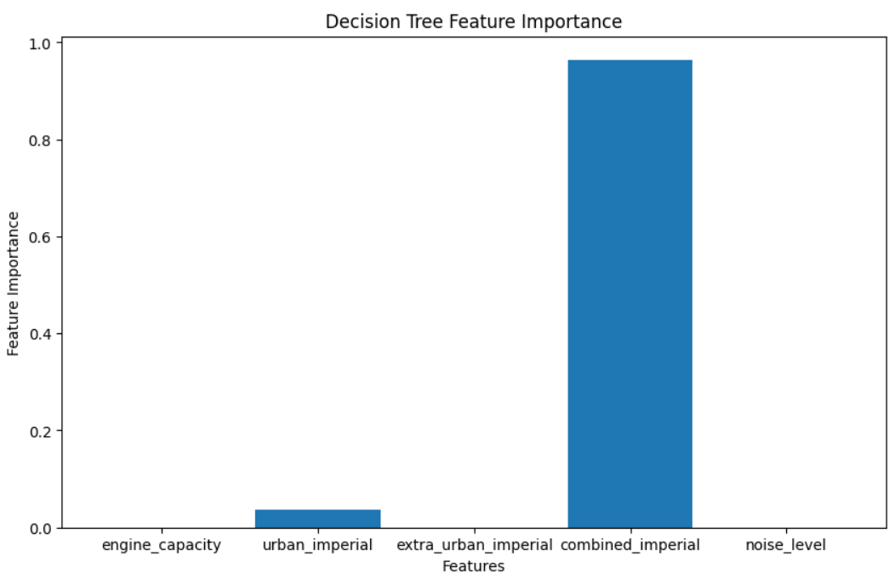
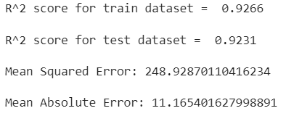
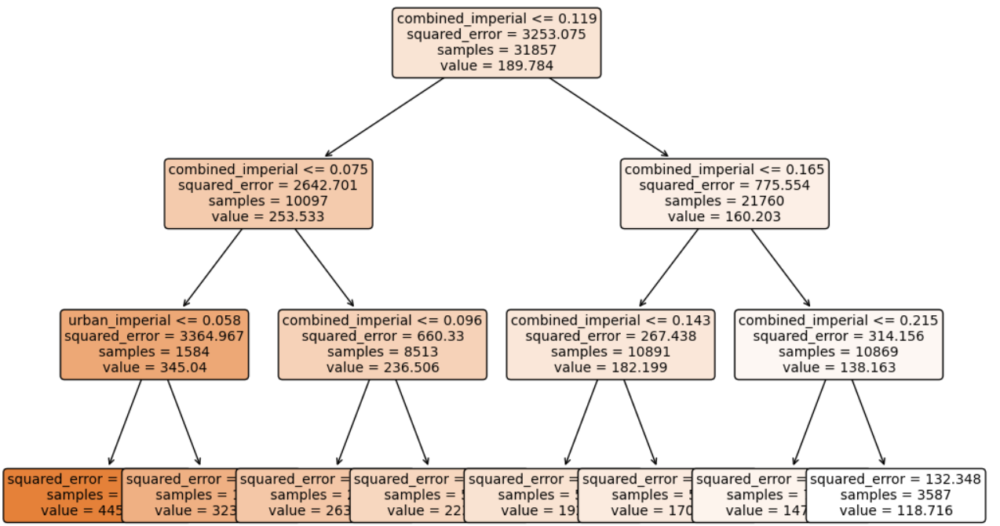
Decision Tree Regression

Slide 30
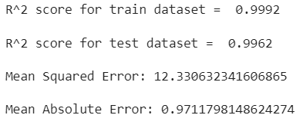
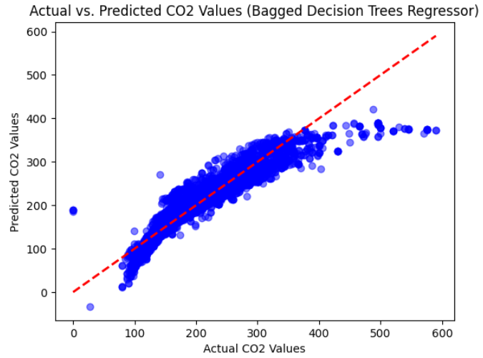
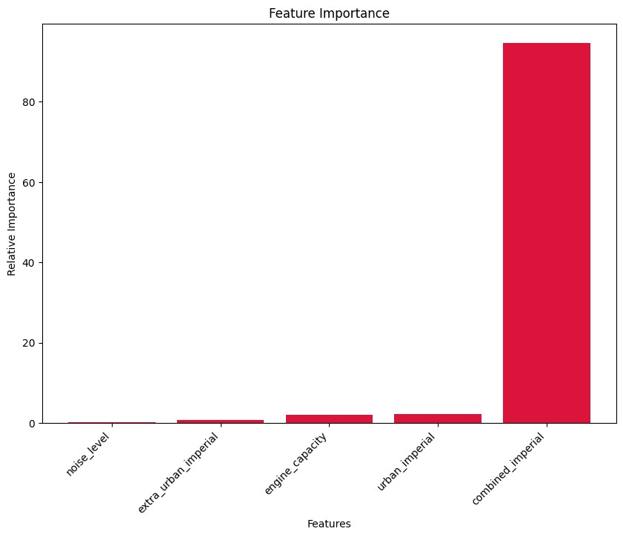
Bagged Decision Trees Regression

Slide 31
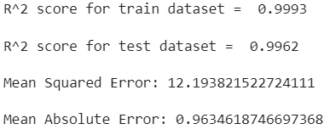
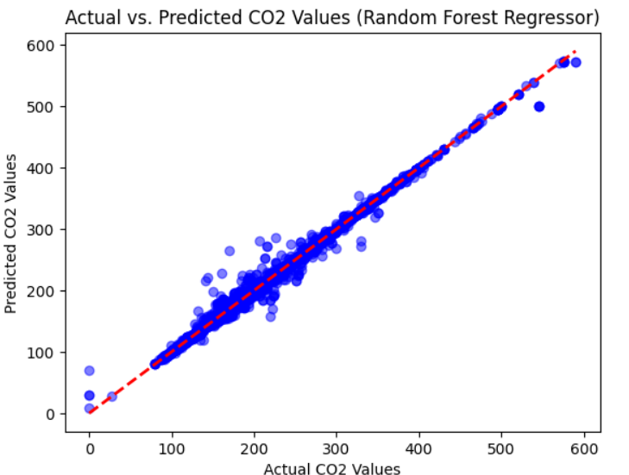
Random Forest Regression

Slide 32
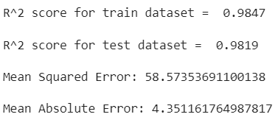
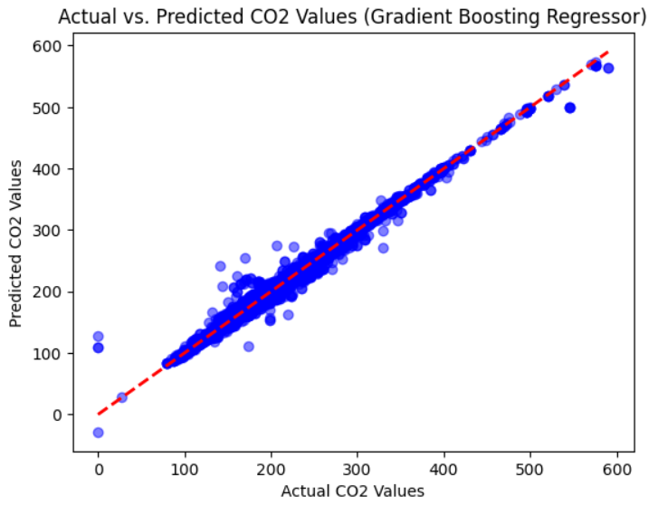
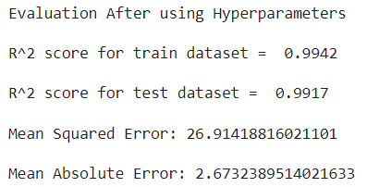
Gradient Boosting Regressor

Slide 33
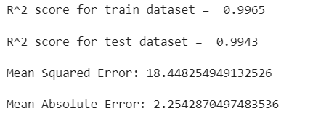
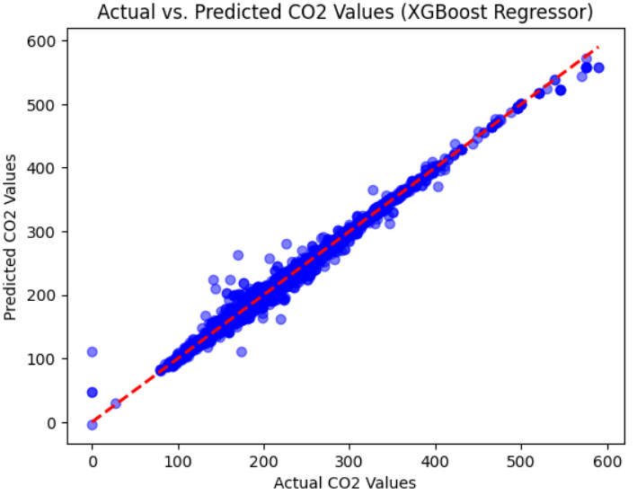
Extreme Gradient Boosting Regressor

Slide 34
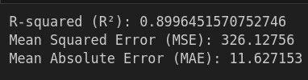
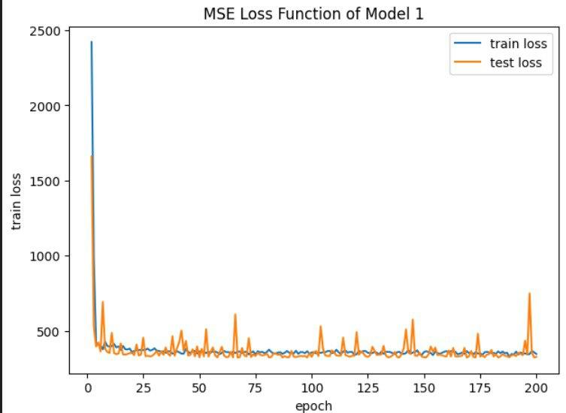
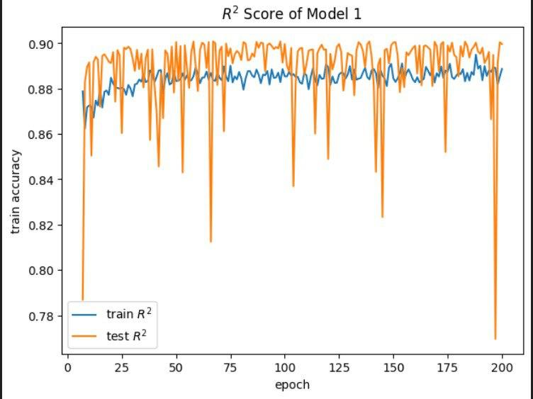
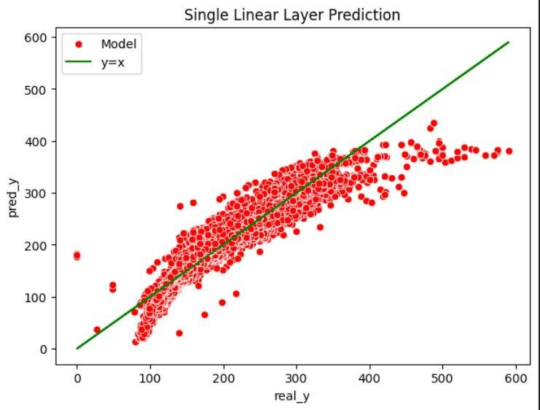
Neural Network

Slide 35
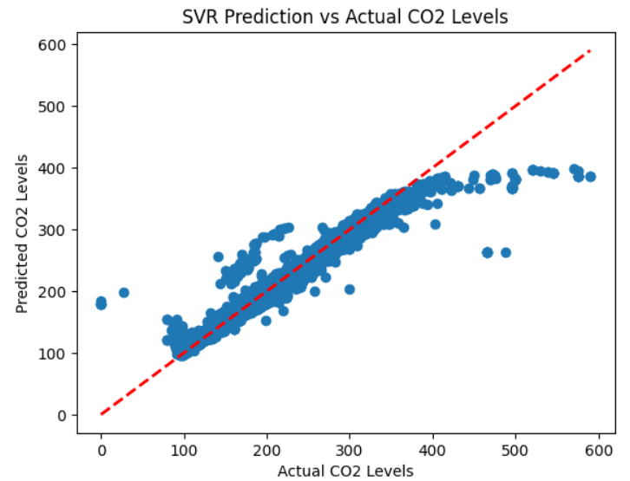
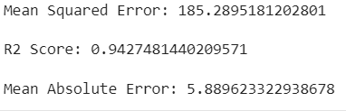
Support vector Regression

Slide 36
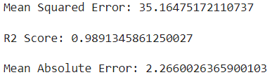
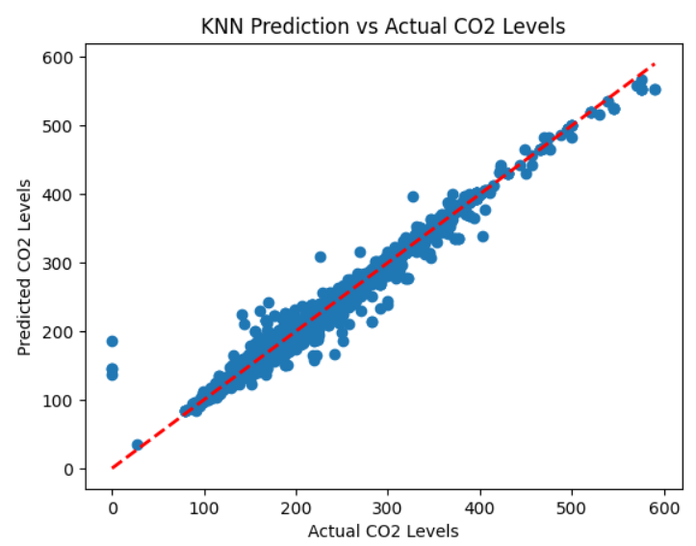
K-Nearest Neighbours (KNN) Regression

Slide 37
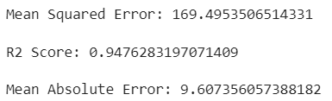
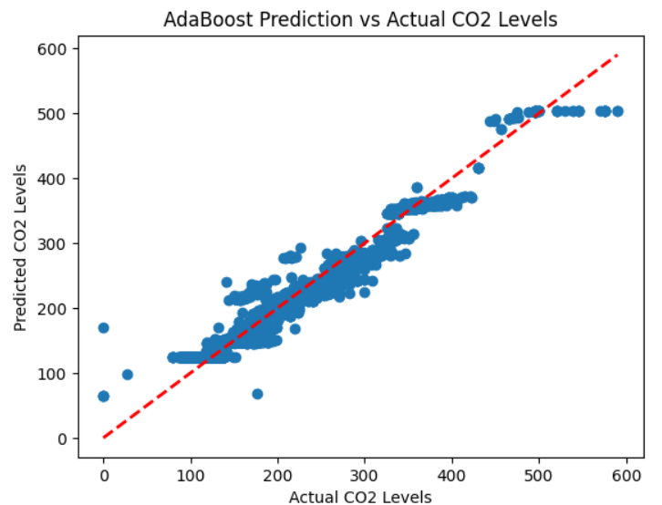
AdaBoost Regression

Slide 38
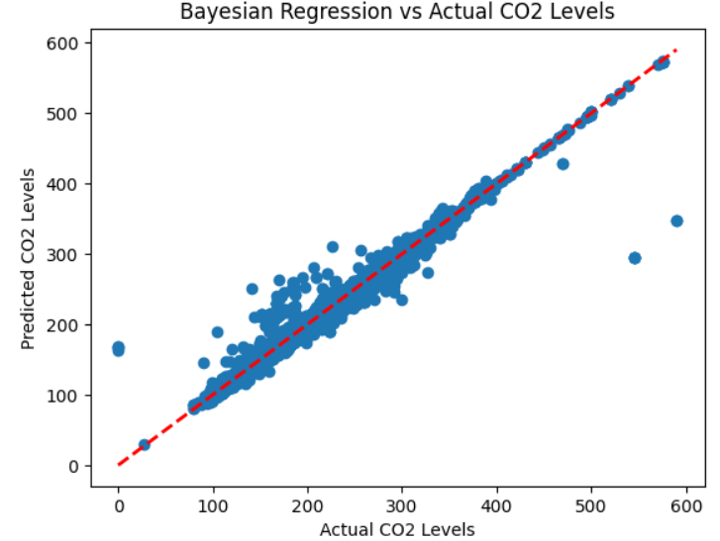
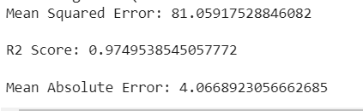
Bayesian Regression

Slide 39
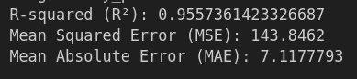
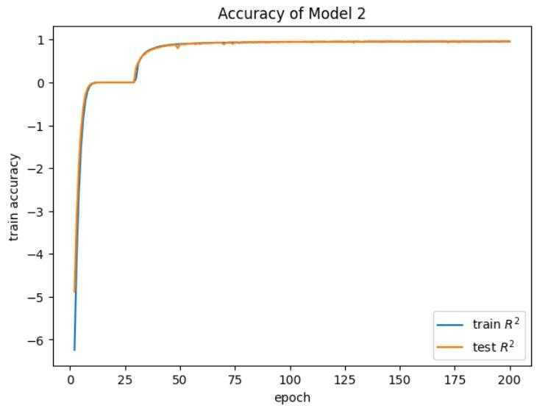
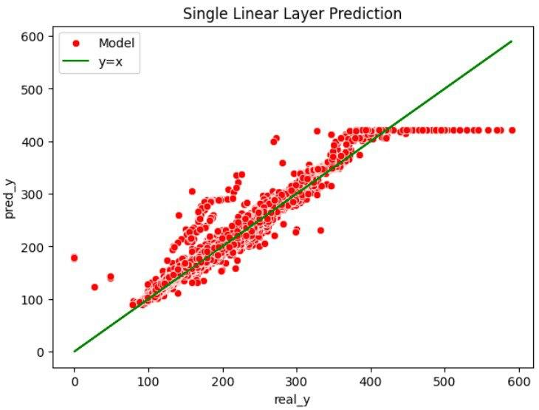
Another NN Model with tanh Activation

Slide 40
Comparison Table For Numerical Target Value
Algorithm | R^2 | MAE | MSE
Linear Regression | 0.8997 | 11.3049 | 324.7142
L1 | 0.8978 | 11.3351 | 330.6377
L2 | 0.8997 | 11.3042 | 324.7119
Decision Tree | 0.9231 | 11.1654 | 248.9287
Bagged Decision Trees Regressor | 0.9962 | 0.9711 | 12.3306
Random Forest Regressor | 0.9962 | 0.9634 | 12.1938
Gradient Boosting Regressor | 0.9819 | 4.3503 | 58.4775
Gradient Boosting Regressor with Hyperparameters | 0.9917 | 2.6731 | 26.9102
Extreme Gradient Boosting Regressor | 0.9943 | 2.2542 | 18.4482
Neural Network | 0.8996 | 11.627 | 326.127
Support Vector Regressor | 0.9427 | 5.8896 | 185.2895
K-Nearest Neighbors (KNN) Regression | 0.9891 | 2.2660 | 35.1647
AdaBoost Regression | 0.9473 | 9.5466 | 170.3429
Bayesian Regression | 0.8996 | 11.3047 | 324.7135
Neural Network 2 | 0.955 | 7.11 | 143.84

Slide 41
Comparison Table For Numerical Target Value with categorical columns
Algorithm | R^2 | MAE | MSE
Linear Regression | 0.9006 | 11.1420 | 321.7774
L1 | 0.8988 | 11.1963 | 327.6635
L2 | 0.9006 | 11.142 | 321.7783
Decision Tree | 0.9231 | 11.1654 | 248.9287
Bagged Decision Trees Regressor | 0.9982 | 0.6501 | 5.9398
Random Forest Regressor | 0.9982 | 0.6418 | 5.7423
Gradient Boosting Regressor | 0.9942 | 2.4522 | 18.6936
Gradient Boosting Regressor with Hyperparameters | 0.9976 | 1.4857 | 7.7976
Extreme Gradient Boosting Regressor | 0.998 | 1.3170 | 6.4836
Neural Network | 0.88 | 12.33 | 367.67
Support Vector Regressor | 0.9469 | 3.8976 | 171.6427
K-Nearest Neighbors (KNN) Regression | 0.9918 | 2.1962 | 26.2578
AdaBoost Regression | 0.9481 | 9.4625 | 167.8248
Bayesian Regression | 0.9005 | 11.1420 | 321.7771
Neural Network 2 |  | 42.1821 | 3274.6155

Slide 42
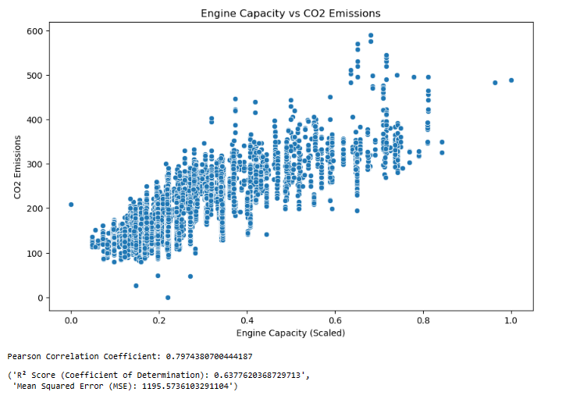
Research Questions:
Determining engine capacity correlation with CO2 emission.

Slide 43
Predicting noise level of a vehicle be predicted based on engine capacity, fuel type, and transmission type?
Difficult to assert that the noise level of a vehicle can be accurately predicted based solely on engine capacity, fuel type, and transmission type, at least not with the models and features used here.

Slide 44
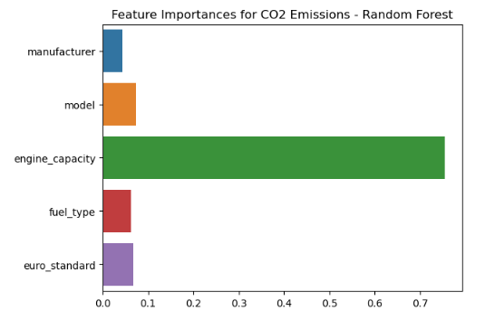
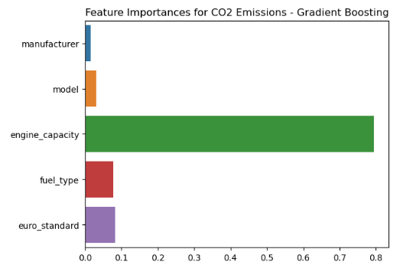
Analyzing if certain manufacturers and models have better emission standards.

Slide 45
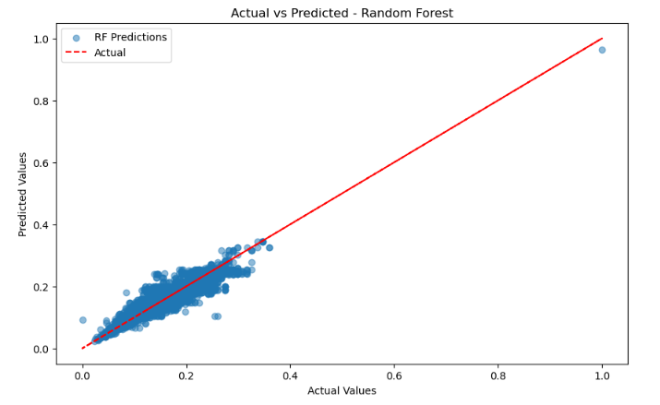
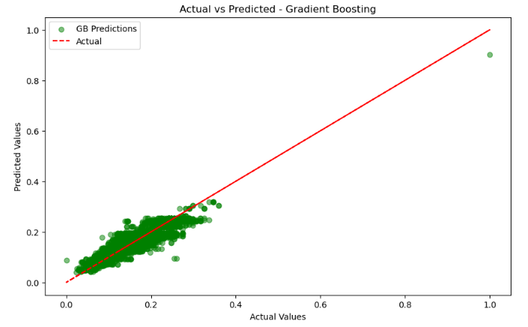
Can engine capacity, transmission type (manual or automatic), and fuel type be used to predict a vehicle's fuel efficiency?

Slide 46
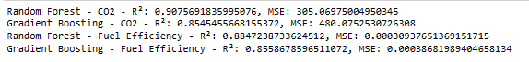


Evaluating CO2 emissions and fuel efficiency based on vehicle's model year.

Slide 47
Conclusion
Observations:
Best R^2: Bagged Decision Trees Regressor and Random Forest Regressor have the highest R^2, indicating excellent model fit.
Best MSE and MAE: Bagged Decision Trees Regressor and Random Forest Regressor have the lowest MSE and MAE, suggesting superior predictive accuracy.
Worst Performer: Neural Network 2 has negative R^2, suggesting that it performs worse than a model predicting the mean of the target.
Overall Recommendation: Bagged Decision Trees Regressor and Random Forest Regressor appear to be the best-performing models based on the provided metrics.

Slide 48
References
Freund, Y., & Schapire, R. E. (1997). A decision-theoretic generalization of on-line learning and an application to boosting. Journal of Computer and System Sciences, 55(1), 119-139. doi:10.1006/jcss.1997.1504.
Park, T., & Casella, G. (2008). The Bayesian Lasso. Journal of the American Statistical Association, 103(482), 681-686. doi:10.1198/016214508000000337.
Altman, N. S. (1992). An introduction to kernel and nearest-neighbor nonparametric regression. The American Statistician, 46(3), 175-185. doi:10.1080/00031305.1992.10475879.

